Slide 1

Linear Modelling: Simple Regression
7th of February 2023
R. Nicholls / D.-L. Couturier / C.S.R. Chilamakuri

Slide 2
Introduction:
ANOVA
Used for testing hypotheses regarding differences between groups
Considers the variation within and between groups
Regression
Used for revealing and investigating relationships between input and output variables
Aim is to model data, and extrapolate as much information as possible
Notes:
Given a particular functional form, model parameters are estimated
Hypothesis testing can be performed as a consequence

Slide 3
Correlation:
How to measure the strength of a linear relationship between variables?

Slide 4
Correlation:

Slide 5
Correlation:

Slide 6
Correlation:

Slide 7
Correlation:

Slide 8
Correlation:

Slide 9
Correlation:

Slide 10
Correlation:

Slide 11
Correlation:

Slide 12
Correlation:

Slide 13
Correlation:
Positively correlated:
Negatively correlated:
Uncorrelated:

Slide 14
Correlation:
Pearson’s product-moment correlation coefficient:
Coefficient of Variation (R² value):

Slide 15
Correlation:
r = 0.931
R² = 0.866
r = -0.949
R² = 0.901

Slide 16
Correlation:
r = -0.060
R² = 0.004
r = 0.106
R² = 0.011

Slide 17
Can I say whether my data are correlated?
Is an observed correlation significant?
Correlation:
data: x and y
t = 17.613, df = 48, p-value < 2.2e-16
alternative hypothesis: true correlation is not equal to 0
95 percent confidence interval:
0.8802556 0.9602168
sample estimates:
cor
0.9305923
data: x and y
t = 1.5609, df = 48, p-value = 0.1251
alternative hypothesis: true correlation is not equal to 0
95 percent confidence interval:
-0.06238066 0.46941403
sample estimates:
cor
0.2197833

Slide 18
Simple Regression:
Aims:
To investigate linear correlation between two variables in more detail
Be able to predict a response given knowledge of the independent variable
Response variable
Dependent variable
Predictor variable
Independent variable

Slide 19
Simple Regression:
Aims:
To investigate linear correlation between two variables in more detail
Be able to predict a response given knowledge of the independent variable
Response variable
Dependent variable
Predictor variable
Independent variable

Slide 20
Simple Regression:
Aims:
To investigate linear correlation between two variables in more detail
Be able to predict a response given knowledge of the independent variable
Response variable
Dependent variable
Predictor variable
Independent variable

Slide 21
Simple Regression:
Aims:
To investigate linear correlation between two variables in more detail
Be able to predict a response given knowledge of the independent variable
x_{i}
ε_{i}
Response variable
Dependent variable
y_{i}
For the i^{th} observation:
ε_{i} = errors, residuals
Predictor variable
Independent variable

Slide 22
Simple Regression:
So how do we fit the regression line?
Suppose we know parameter estimates and
Observations:
x_{i}
ε_{i}
y_{i}

Slide 23
Simple Regression:
So how do we fit the regression line?
Suppose we know parameter estimates and
Observations:
Fitted values:
x_{i}
ε_{i}
y_{i}
ŷ_{i}

Slide 24
Simple Regression:
So how do we fit the regression line?
Suppose we know parameter estimates and
Residuals:
x_{i}
ε_{i}
y_{i}
ŷ_{i}

Slide 25
Simple Regression:
So how do we fit the regression line?
Suppose we know parameter estimates and
Residuals:
x_{i}
ε_{i}
y_{i}
ŷ_{i}

Slide 26
Simple Regression:
So how do we fit the regression line?
Suppose we know parameter estimates and
Residuals:
x_{i}
ε_{i}
y_{i}
ŷ_{i}

Slide 27
Simple Regression:
So how do we fit the regression line?
Suppose we know parameter estimates and
Residuals:
x_{i}
ε_{i}
y_{i}
ŷ_{i}

Slide 28
Simple Regression:
So how do we fit the regression line?
Obtain estimates and
Maximise likelihood of parameters given the data
x_{i}
ε_{i}
y_{i}
ŷ_{i}

Slide 29
Simple Regression:
So how do we fit the regression line?
Obtain estimates and
Maximise likelihood of parameters given the data
x_{i}
ε_{i}
y_{i}
ŷ_{i}

Slide 30


Simple Regression:
So how do we fit the regression line?
Obtain estimates and
Maximise likelihood of parameters given the data
x_{i}
ε_{i}
y_{i}
ŷ_{i}
Optimal parameters : minimise residual sum of squares
Maximum Likelihood and Least Squares estimates are equivalent (for Gaussian error model)

Slide 31
Simple Regression:
So how do we fit the regression line?
Obtain estimates and
Maximise likelihood of parameters given the data
Optimal parameters : minimise residual sum of squares
Maximum Likelihood and Least Squares estimates are equivalent (for Gaussian error model)

Slide 32


Simple Regression:
So how do we fit the regression line?
Obtain estimates and
Maximise likelihood of parameters given the data
Minimise sum of squared residuals
Final answer:

Slide 33
Simple Regression:
Example: Predicting timber volume of felled black cherry trees
> cor(trees$Volume,trees$Girth)
[1] 0.9671194
> m1 = lm(Volume~Girth,data=trees)
> summary(m1)
Call:
lm(formula = Volume ~ Girth, data = trees)
Residuals:
Min 1Q Median 3Q Max
-8.065 -3.107 0.152 3.495 9.587
Coefficients:
Estimate Std. Error t value Pr(>|t|)
(Intercept) -36.9435 3.3651 -10.98 7.62e-12 ***
Girth 5.0659 0.2474 20.48 < 2e-16 ***
---
Signif. codes: 0 ‘***’ 0.001 ‘**’ 0.01 ‘*’ 0.05 ‘.’ 0.1 ‘ ’ 1
Residual standard error: 4.252 on 29 degrees of freedom
Multiple R-squared: 0.9353, Adjusted R-squared: 0.9331
F-statistic: 419.4 on 1 and 29 DF, p-value: < 2.2e-16
Response: y = Volume
Predictor: x = Girth

Slide 34
Simple Regression:
Example: Predicting timber volume of felled black cherry trees
> cor(trees$Volume,trees$Girth)
[1] 0.9671194
> m1 = lm(Volume~Girth,data=trees)
> summary(m1)
Call:
lm(formula = Volume ~ Girth, data = trees)
Residuals:
Min 1Q Median 3Q Max
-8.065 -3.107 0.152 3.495 9.587
Coefficients:
Estimate Std. Error t value Pr(>|t|)
(Intercept) -36.9435 3.3651 -10.98 7.62e-12 ***
Girth 5.0659 0.2474 20.48 < 2e-16 ***
---
Signif. codes: 0 ‘***’ 0.001 ‘**’ 0.01 ‘*’ 0.05 ‘.’ 0.1 ‘ ’ 1
Residual standard error: 4.252 on 29 degrees of freedom
Multiple R-squared: 0.9353, Adjusted R-squared: 0.9331
F-statistic: 419.4 on 1 and 29 DF, p-value: < 2.2e-16
Response: y = Volume
Predictor: x = Girth

Slide 35
Simple Regression:
Example: Predicting timber volume of felled black cherry trees
> cor(trees$Volume,trees$Girth)
[1] 0.9671194
> m1 = lm(Volume~Girth,data=trees)
> summary(m1)
Call:
lm(formula = Volume ~ Girth, data = trees)
Residuals:
Min 1Q Median 3Q Max
-8.065 -3.107 0.152 3.495 9.587
Coefficients:
Estimate Std. Error t value Pr(>|t|)
(Intercept) -36.9435 3.3651 -10.98 7.62e-12 ***
Girth 5.0659 0.2474 20.48 < 2e-16 ***
---
Signif. codes: 0 ‘***’ 0.001 ‘**’ 0.01 ‘*’ 0.05 ‘.’ 0.1 ‘ ’ 1
Residual standard error: 4.252 on 29 degrees of freedom
Multiple R-squared: 0.9353, Adjusted R-squared: 0.9331
F-statistic: 419.4 on 1 and 29 DF, p-value: < 2.2e-16
Response: y = Volume
Predictor: x = Girth

Slide 36
Simple Regression:
Example: Predicting timber volume of felled black cherry trees
> cor(trees$Volume,trees$Girth)
[1] 0.9671194
> m1 = lm(Volume~Girth,data=trees)
> summary(m1)
Call:
lm(formula = Volume ~ Girth, data = trees)
Residuals:
Min 1Q Median 3Q Max
-8.065 -3.107 0.152 3.495 9.587
Coefficients:
Estimate Std. Error t value Pr(>|t|)
(Intercept) -36.9435 3.3651 -10.98 7.62e-12 ***
Girth 5.0659 0.2474 20.48 < 2e-16 ***
---
Signif. codes: 0 ‘***’ 0.001 ‘**’ 0.01 ‘*’ 0.05 ‘.’ 0.1 ‘ ’ 1
Residual standard error: 4.252 on 29 degrees of freedom
Multiple R-squared: 0.9353, Adjusted R-squared: 0.9331
F-statistic: 419.4 on 1 and 29 DF, p-value: < 2.2e-16
95% within ±8.5
Response: y = Volume
Predictor: x = Girth

Slide 37
Linear Regression:
Assumptions:
Model is linear in parameters.

Slide 38
Linear Regression:
Assumptions:
Model is linear in parameters.

Slide 39
Linear Regression:
Assumptions:
Model is linear in parameters.

Slide 40
Linear Regression:
Assumptions:
Model is linear in parameters.

Slide 41
Linear Regression:
Assumptions:
Model is linear in parameters.

Slide 42
Linear Regression:
Assumptions:
Model is linear in parameters.
Gaussian error model.

Slide 43
Linear Regression:
Assumptions:
Model is linear in parameters.
Gaussian error model.
Additive error model.

Slide 44
Linear Regression:
Assumptions:
Model is linear in parameters.
Gaussian error model.
Additive error model.

Slide 45
Linear Regression:
Assumptions:
Model is linear in parameters.
Gaussian error model.
Additive error model.
Independence of errors. No autocorrelation – when one observation depends on another

Slide 46
Linear Regression:
Assumptions:
Model is linear in parameters.
Gaussian error model.
Additive error model.
Independence of errors. No autocorrelation – when one observation depends on another
Homoscedasticity. Homogeneity / stability of variance of the residuals

Slide 47
Testing Assumptions: diagnostic plots
Residuals vs Fitted Values
Should not be related
No visible pattern
Mean residual = zero
Constant variance

Slide 48
Testing Assumptions: diagnostic plots
Residuals vs Fitted Values
Normal Quantile-Quantile Plot
Visual test for Normality
No strong trends/departures

Slide 49
Testing Assumptions: diagnostic plots
Residuals vs Fitted Values
Normal Quantile-Quantile Plot
Scale-Location Plot
Test for homoscedasticity
Should be constant, ≈1
No trend

Slide 50
Testing Assumptions: diagnostic plots
Residuals vs Fitted Values
Normal Quantile-Quantile Plot
Scale-Location Plot
Index Plot of Cook’s Distance
Measures the influence of a particular observation
Extreme x-vals : high leverage
May inform outlier rejection

Slide 51
Modelling Non-Linear Relationships
Linear models can be used to describe non-linear relationships…
Applying transformations to response and/or predictor variables can be useful to:
Linearise the data, i.e. make the relationship between variables more linear.
Stabilise the variance of the residuals, so that σ² doesn’t depend on the independent variable.
Normalise the distribution of the residuals

Slide 52
Modelling Non-Linear Relationships
Example: Stopping distance of cars versus speed (mph)
Response: y = distance
Predictor: x = speed

Slide 53
Modelling Non-Linear Relationships
Example: Stopping distance of cars versus speed (mph)
R² = 0.651
Response: y = distance
Predictor: x = speed

Slide 54
Modelling Non-Linear Relationships
Example: Stopping distance of cars versus speed (mph)
R² = 0.651
R² = 0.709
Response: y = distance
Predictor: x = speed

Slide 55
Modelling Non-Linear Relationships
Example: Stopping distance of cars versus speed (mph)
R² = 0.651
R² = 0.709
R² = 0.733
Response: y = distance
Predictor: x = speed

Slide 56
Modelling Non-Linear Relationships
Example: Stopping distance of cars versus speed (mph)
R² = 0.651
R² = 0.709
R² = 0.733
Call:
lm(formula = log(dist) ~ log(speed), data = cars)
Residuals:
Min 1Q Median 3Q Max
-1.00215 -0.24578 -0.02898 0.20717 0.88289
Coefficients:
Estimate Std. Error t value Pr(>|t|)
(Intercept) -0.7297 0.3758 -1.941 0.0581 .
log(speed) 1.6024 0.1395 11.484 2.26e-15 ***
---
Signif. codes: 0 ‘***’ 0.001 ‘**’ 0.01 ‘*’ 0.05 ‘.’ 0.1 ‘ ’ 1
Residual standard error: 0.4053 on 48 degrees of freedom
Multiple R-squared: 0.7331, Adjusted R-squared: 0.7276
F-statistic: 131.9 on 1 and 48 DF, p-value: 2.259e-15
Response: y = distance
Predictor: x = speed

Slide 57
Modelling Non-Linear Relationships
Can you use simple regression to fit this model?
Non-linear
Multiplicative error model

Slide 58
Modelling Non-Linear Relationships
Can you use simple regression to fit this model?
Non-linear
Multiplicative error model

Slide 59
Modelling Non-Linear Relationships
Can you use simple regression to fit this model?
Non-linear
Multiplicative error model
Yes, so long as
Error model is log-Normal.

Slide 60
Modelling Non-Linear Relationships
Example: Stopping distance of cars versus speed (mph)
R² = 0.651
R² = 0.709
R² = 0.733
Call:
lm(formula = log(dist) ~ log(speed), data = cars)
Residuals:
Min 1Q Median 3Q Max
-1.00215 -0.24578 -0.02898 0.20717 0.88289
Coefficients:
Estimate Std. Error t value Pr(>|t|)
(Intercept) -0.7297 0.3758 -1.941 0.0581 .
log(speed) 1.6024 0.1395 11.484 2.26e-15 ***
---
Signif. codes: 0 ‘***’ 0.001 ‘**’ 0.01 ‘*’ 0.05 ‘.’ 0.1 ‘ ’ 1
Residual standard error: 0.4053 on 48 degrees of freedom
Multiple R-squared: 0.7331, Adjusted R-squared: 0.7276
F-statistic: 131.9 on 1 and 48 DF, p-value: 2.259e-15
Response: y = distance
Predictor: x = speed

Slide 61
Simple Regression in R:
Correlation Coefficients:
R functions:
plot(x,y)
cor(x,y)
cor.test(x,y)
data: x and y
t = 17.613, df = 48, p-value < 2.2e-16
alternative hypothesis: true correlation is not equal to 0
95 percent confidence interval:
0.8802556 0.9602168
sample estimates:
cor
0.9305923

Slide 62
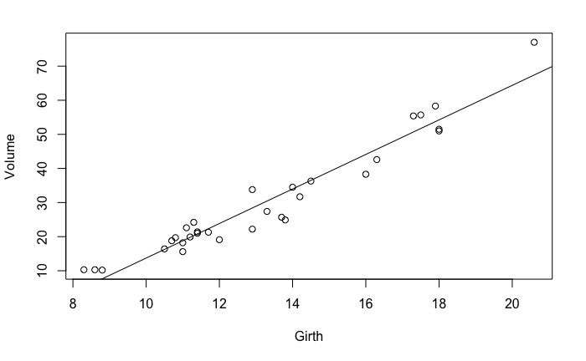
Simple Regression in R:
R functions:
plot(x,y)
m1 <- lm(y~x)
abline(m1)
summary(m1)
Call:
lm(formula = Volume ~ Girth, data = trees)
Residuals:
Min 1Q Median 3Q Max
-8.065 -3.107 0.152 3.495 9.587
Coefficients:
Estimate Std. Error t value Pr(>|t|)
(Intercept) -36.9435 3.3651 -10.98 7.62e-12 ***
Girth 5.0659 0.2474 20.48 < 2e-16 ***
---
Signif. codes: 0 ‘***’ 0.001 ‘**’ 0.01 ‘*’ 0.05 ‘.’ 0.1 ‘ ’ 1
Residual standard error: 4.252 on 29 degrees of freedom
Multiple R-squared: 0.9353, Adjusted R-squared: 0.9331
F-statistic: 419.4 on 1 and 29 DF, p-value: < 2.2e-16

Slide 63
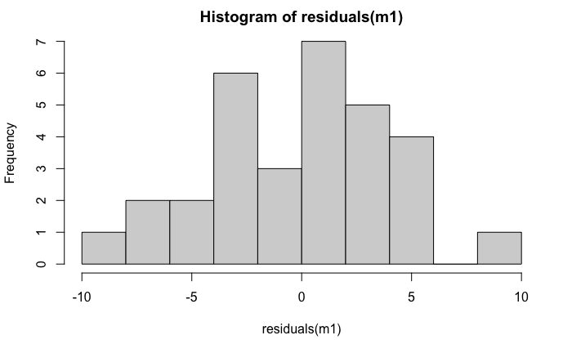
Simple Regression in R:
R functions:
plot(x,y)
m1 <- lm(y~x)
abline(m1)
summary(m1)
r1 <- residuals(m1)
hist(r1)

Slide 64
Simple Regression in R:
R functions:
plot(x,y)
m1 <- lm(y~x)
abline(m1)
summary(m1)
r1 <- residuals(r1)
hist(r1)
plot(m1)

